Slide 1
A NP-Complete Problem
Travelling Salesman Problem
Submitted By:-
Name : Kusum Sharma
Enrollment No:- 00602102023
Department: MtechCSE(AI)
Submitted to :-
Dr. Jha
CSE Dept

Slide 2
Introduction
In the field of computer science and algorithms, the efficiency of an algorithm is a critical factor. The best algorithms are those that minimize both the time and space required for problem-solving.
Algorithms are often classified based on their time complexity, which can be either polynomial or non-polynomial.
1. Polynomial Time Complexity (P): Algorithms falling into the P category can solve problems in polynomial time. Examples of polynomial time complexities include O(n) and O(n^2).
2. Non-Polynomial Time Complexity (NP): NP includes problems where the solutions can be efficiently verified in polynomial time. Example of non-polynomial time complexity is O(2^n).
Within NP problems, there are two key subdivisions:
1. NP-Hard: A problem is classified as NP-Hard if it is at least as hard as the hardest problems in NP.
2. NP-Complete (NPC): NP-Complete problems are a subset of NP problems that are both in NP and NP-Hard.

Slide 3
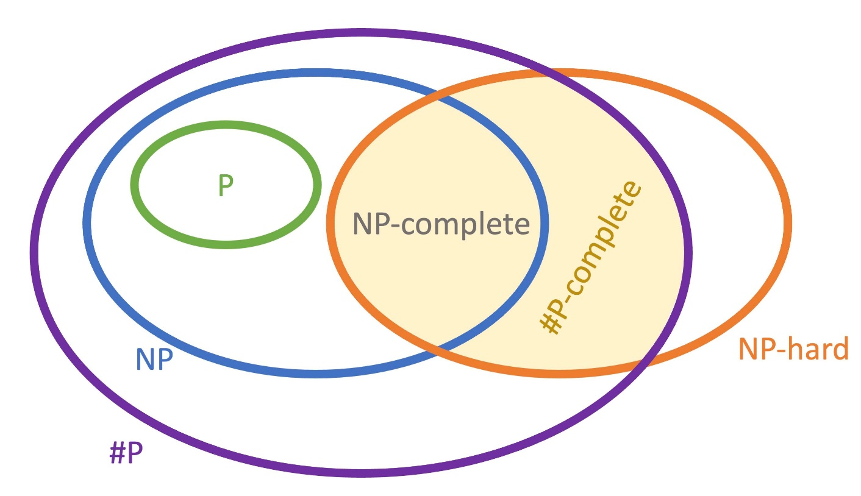
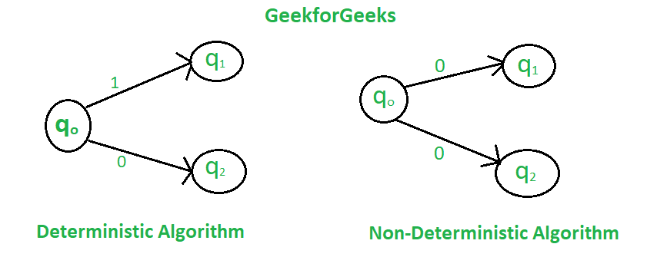
Introduction
Representation of NP, P, NPC, NP-Hard
Types of Algorithm

Slide 4
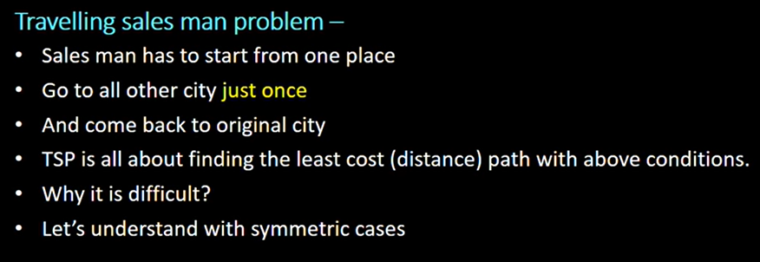
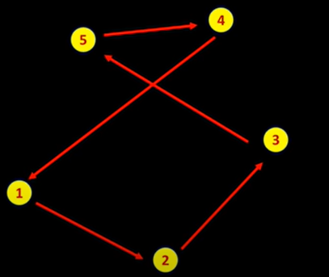
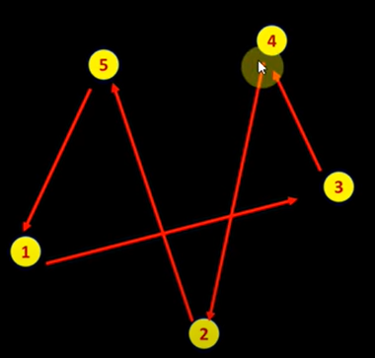
Travelling Sales Man Problem (TSP) why it is NP Hard
NP-hard − The class of problem which cannot be solved within a polynomial time is called NP-hard
Solutions can be different:-

Slide 5
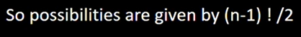
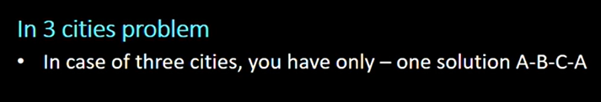
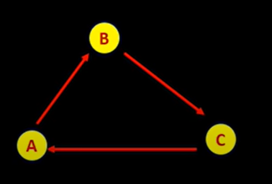

Slide 6
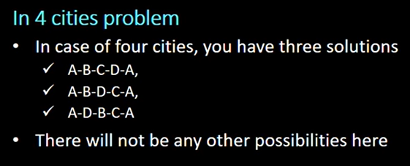
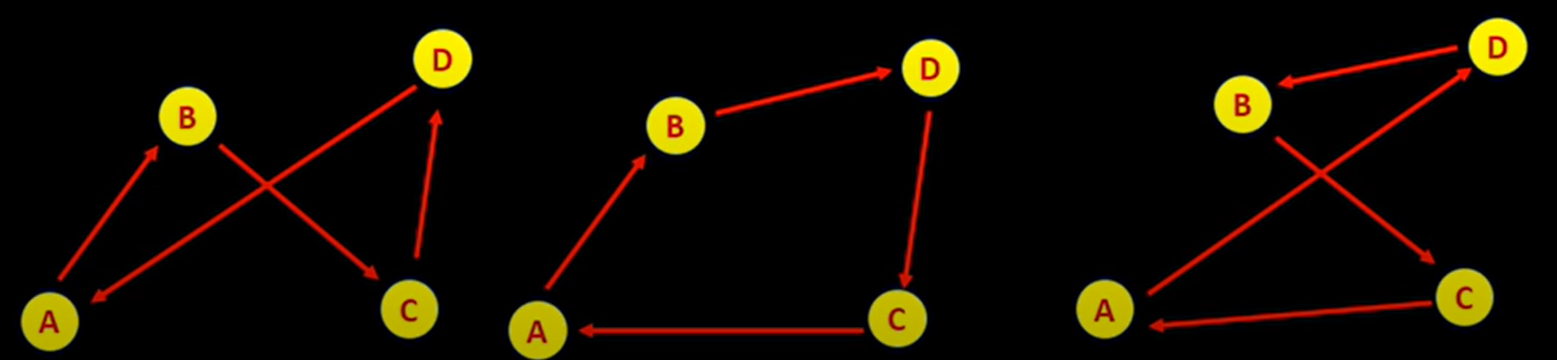

Slide 7
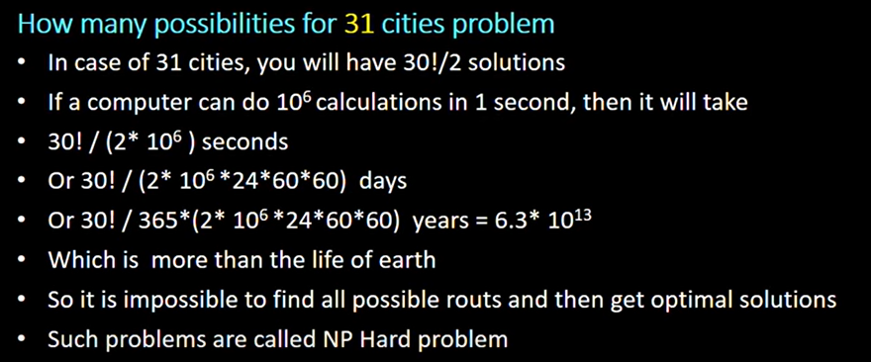
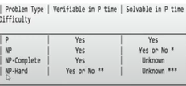
Now,Why it is computationally difficulty

Slide 8
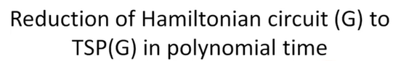
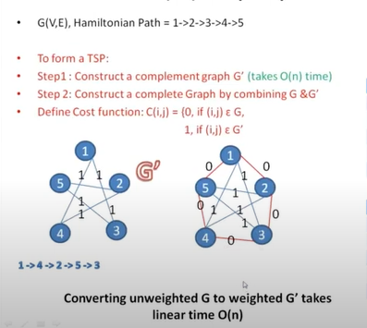
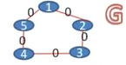
Proof: TSP is a NP Complete Problem
Graph G has a Hamiltonian cycle.
Graph G' has a tour with total weight n.

Slide 9

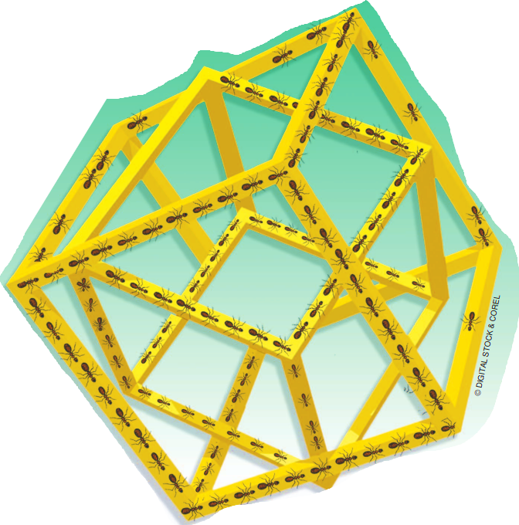
PAPER 1

Slide 10
Ant Colony Optimization Outline
First ACO algorithm was Ant System (AS) in 1991
Biological Inspiration of Ant Colony Optimisation:-
Ant Colony Optimization (ACO) is inspired by the foraging behavior of real ants. The biological inspiration comes from the observation of how ant colonies efficiently find the shortest path between their nest and a food source.
How Ants Communicate?
Ants indirectly communicate with each other using Pheromones. It is a Chemical that ants deposit on the ground in order to mark some favourable path that should followed by other members of the colony.

Slide 11
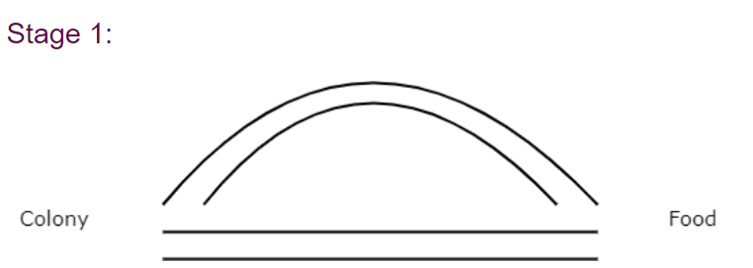
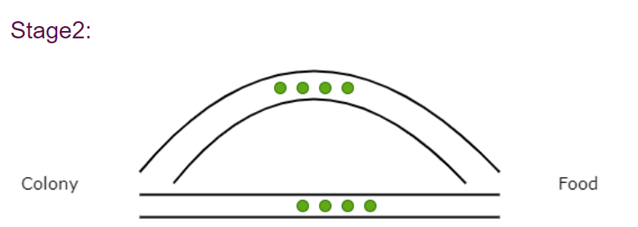
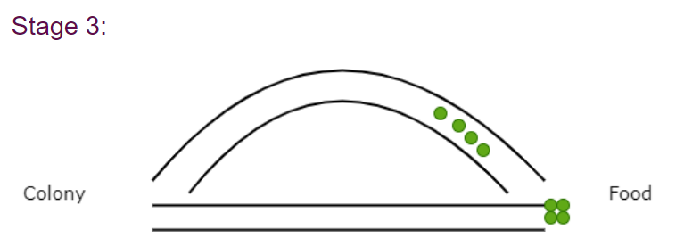
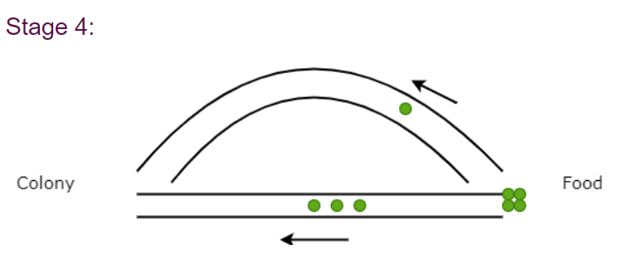
Double Bridge Experiment:-
Principle of Ant Colony Optimization:-

Slide 12
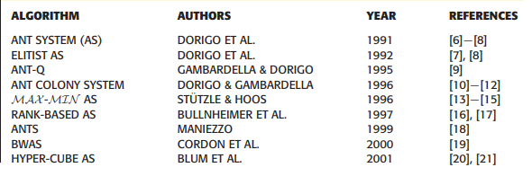
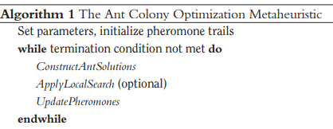
Successful Ant Colony Ant Optimization Algorithms:-

Slide 13
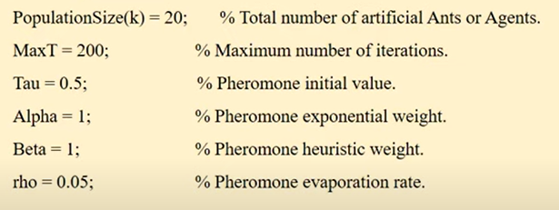
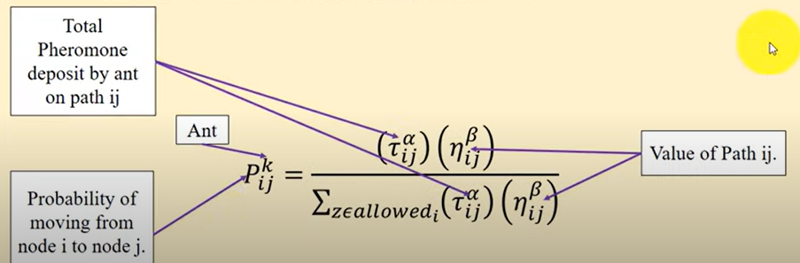
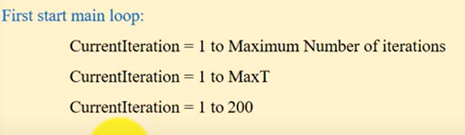
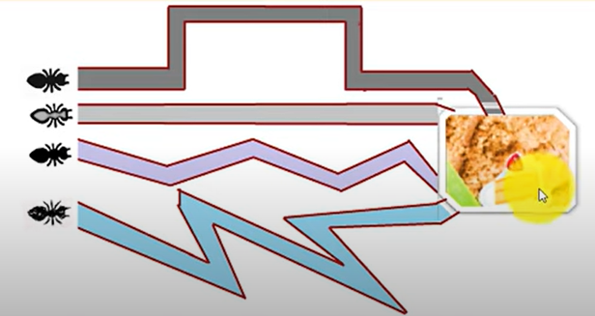
ACO(Ant Colony Optimization) Algorthim step-by-step:-
Step 1. Inititalize ACO Parameters
Step 3 :- Place each ant in the Starting Node:-
Step 2 : Construct Ant Solution
Here kth ant move from node I to node j with probability.

Slide 14
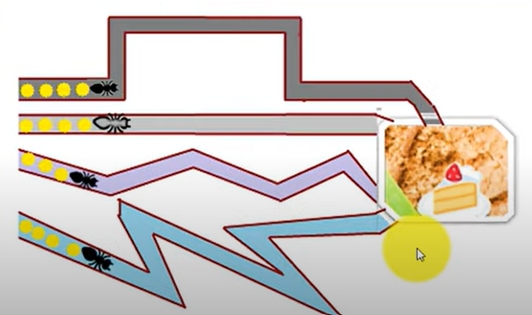
Step 4 :- Each ant will select next node by applying state transition rule.
Step 5:- Repeat until ant build the best solution , then compute the fitness value.
Step 6:- Update the best solution
Compare the best solution with easy ant solution
If (ant(k) solution < Best Solution)
{
Consider Ant(k) Best Solution
}

Slide 15
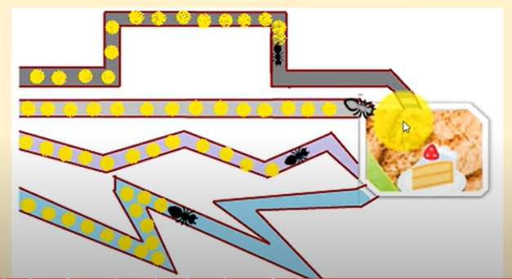
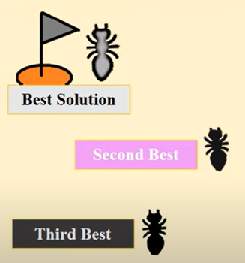
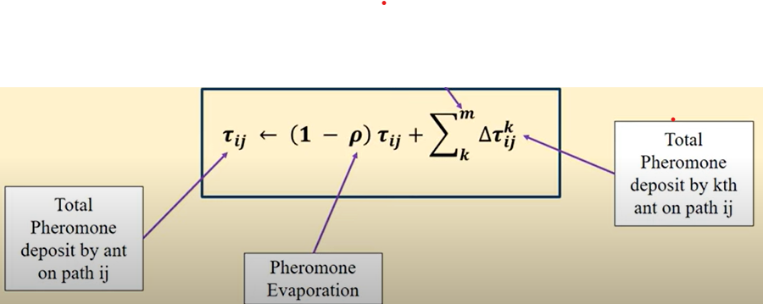
Step 7 :-Apply offline Pheromone update
(Note- Pheromone trail are updated when all ants complete their cost/solution)
Case 1 – For best solution Increase the level of Pheromone Trials
Case 2 - For worst solution Decrease the level of Pheromone Trials
Pheromone Level Updating Equation:-

Slide 16
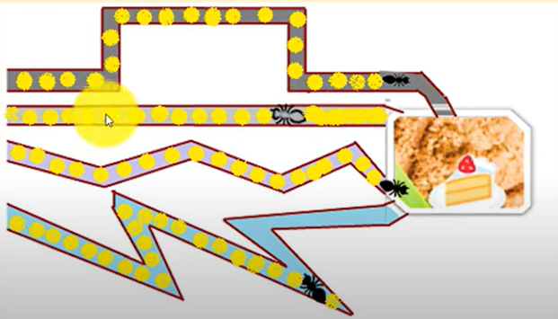
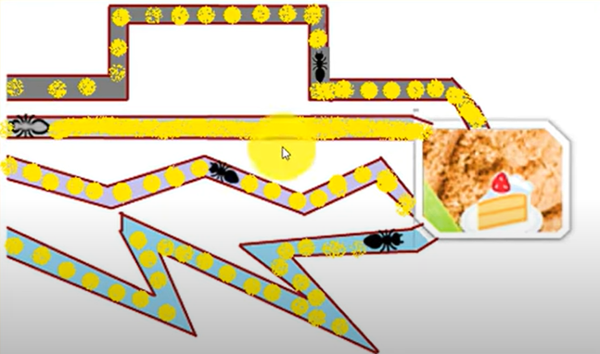
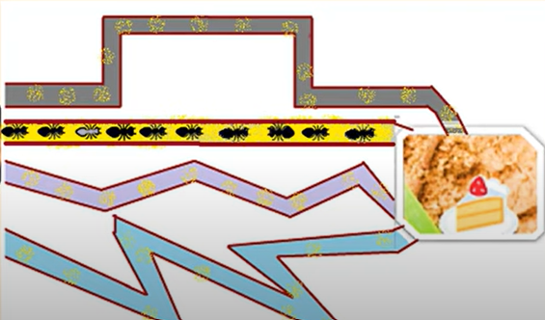
Step 8 – Display the Best Solution

Slide 17
Mathematical Formulation:
Let G = (V, E) be a complete undirected graph with n vertices, where V = {v1, v2, ..., vn} is the set of vertices and E is the set of edges. Let d(u, v) be the distance between vertices u and v. The TSP is to find the shortest Hamiltonian cycle in G, which is a cycle that visits each vertex exactly once.
The ACO algorithm can be formalized as follows:
Input: A complete undirected graph G with n vertices and edge weights d(u, v) Output: An approximate tour T of the TSP Initialize a set of initial solutions S while the termination criterion is not met for each ant in S Construct a solution T' by probabilistically selecting the next city to visit Update the pheromone levels on the edges in T' Apply local search to T' end for Replace the worst solution in S with the best solution constructed in the current iteration end while Output the best solution in S

Slide 18
ACO algorithms have these defining characteristics:
1) Ant System:
All ants update pheromone trails after constructing solutions
2) MAX-MIN Ant System:
Only the best ant updates pheromones
Pheromone values bounded between max and min
3) Ant Colony System:
Has local pheromone update while ants construct a solution
Uses pseudorandom proportional rule for solution construction

Slide 19
Problems ACO Has Solved Effectively
Main Benefits of Ant Colony Optimization
Well suited for hard combinatorial problems
Adaptive, distributed technique provides resilience
Connections to biological systems
Continues to find innovative applications after decades
Traveling salesman problem and vehicle routing
Scheduling and project planning optimization
Telecommunications network routing
Protein folding configurations
Machine learning classification and data mining

Slide 20
Paper 2 :- On the Nearest Neighbor Algorithms for the Traveling Salesman Problem
In this Paper it proposes a hybrid construction algorithm for solving TSP based on the nearest neighbor algorithm and the greedy algorithm. These algorithms are commonly used in TSP problem-solving due to their simplicity and efficiency. Combining them in a hybrid approach aims to leverage their individual strengths for better results.
As in this Research Paper it is mentioned, that there are four main classes of algorithms used to solve the TSP:
Exact Algorithms
Heuristic Algorithms
Approximate Algorithms
Metaheuristics Algorithms

Slide 21
Exact algorithms: These guarantee finding the optimal solution but can be computationally demanding.
Heuristic algorithms: These aim to find good solutions but don't guarantee optimality. They are generally more computationally efficient than exact algorithms.
Approximate algorithms: These provide solutions that are close to optimal but may not be the exact optimal solution.
Metaheuristic algorithms: These are higher-level strategies that guide other heuristics to explore the solution space more efficiently.
Within heuristic algorithms, there are three main classes:
Tour construction algorithms: These gradually build a tour by adding a new city at each step.
Tour improvement algorithms: These enhance an existing tour by performing various exchanges.
Hybrid algorithms: These combine both construction and improvement heuristics simultaneously.

Slide 22
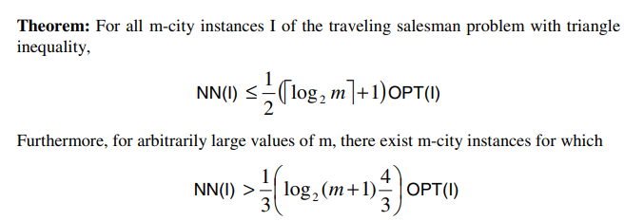
1)The Nearest Neighbour(NN)
Nearest Neighbor (NN) Algorithm
Start at random city
Visit nearest unvisited city
Repeat step 2 until all cities visited
Return to starting city

Slide 23
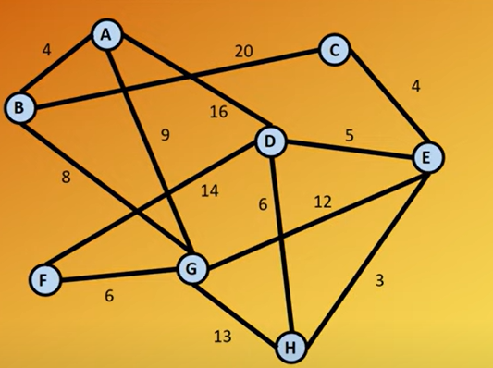
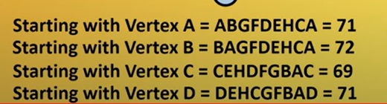
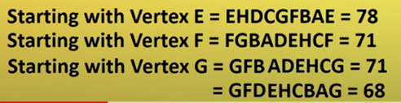
Example of NN:-

Slide 24
2) The Nearest Neighbor Algorithm (NND) from Both End-Points
The Nearest Neighbor Algorithm from Both End-Points (NND) is a modification of the classic Nearest Neighbor (NN) algorithm for solving the Traveling Salesman Problem (TSP). The NND algorithm introduces a variation in the way it selects the next city to visit, considering two end vertices instead of one. NND algorithm is a heuristic Algorithm.
Here are the steps of the NND algorithm:
Choose an Arbitrary Vertex:
Start by selecting an arbitrary vertex in the graph as the starting point.
Visit the Nearest Unvisited Vertex:
Move to the nearest unvisited vertex from the current vertex.
Visit the Nearest Unvisited Vertex to Both End Vertices:
Add a vertex to the tour that has not been visited before and is the nearest to both the current vertex and the starting vertex. Update the end vertices to include this newly visited vertex.
Check for Unvisited Vertices:
If there are still unvisited vertices, go back to step 3 and repeat the process.
Return to the Starting Vertex from the Other End Vertex:
Once all vertices are visited, return to the starting vertex from the other end vertex to complete the tour.

Slide 25
3) Greedy Algorithm
The Greedy Algorithm described is a heuristic approach for solving the Traveling Salesman Problem (TSP). The algorithm constructs a tour by iteratively selecting the shortest edge and adding it to the tour, subject to certain constraints. The goal is to gradually build a tour that visits all cities while avoiding cycles with fewer than N edges and limiting the increase in the degree of any node by more than 2.
Here are the steps of the Greedy Algorithm:
Sort Edges by Increasing Lengths:
Arrange the edges of the graph in ascending order based on their lengths (distances).
Select the Shortest Edge and Add to Tour:
Choose the shortest edge from the sorted list.
Add the selected edge to the tour if adding it doesn't violate the specified constraints:
It doesn't create a cycle with fewer than N edges.
It doesn't increase the degree of any node by more than 2.
The same edge is not added twice.
Check for the Number of Edges in the Tour:
Verify whether the number of edges in the tour is equal to N (the total number of cities).
If not, go back to step 2 and repeat the process.

Slide 26
4) Hybrid algorithm NNDG
The Hybrid algorithm described, named NNDG (a hybrid of NND and Greedy algorithms), combines aspects of the Nearest Neighbor from Both End-Points (NND) algorithm and the Greedy algorithm. It aims to benefit from the strengths of both algorithms to find a solution to the Traveling Salesman Problem (TSP). Below are the steps of the NNDG algorithm:
Find the Vertex with the Smallest Row-Sum:
Compute the row-sum for each vertex by summing the entries in its row in the adjacency matrix.
Identify the vertex with the smallest row-sum.
Apply NND Algorithm Starting from the Smallest Row-Sum Vertex:
Start the NND algorithm from the vertex with the smallest row-sum.
Continue the NND algorithm until reaching a vertex that has been added to the tour before.
Continue Applying NND from the Last Vertex in the Tour:
Repeat the NND algorithm starting from the last vertex in the tour until reaching a vertex that has been added to the tour before.
Calculate [nt/k]
Calculate [nt/k] where n is the number of vertices, t is the number of edges taken from each solution found by NND, and k is the number of implementations of NND.

Slide 27
5. Take First t Edges from Each NND Solution:
Take the first t edges respectively from each solution found by NND.
Add the edges that do not form subtours to the solution.
6. Apply Greedy Algorithm to the Remaining Edges:
Apply the Greedy algorithm to the remaining edges not included in the solution.
Time Complexity
Nearest Neighbor algorithms - O(n^2)
Greedy algorithm - O(n^2 log n)
NNDG hybrid - O(n^2 log n)

Slide 28
Results
Proposed NND algorithm improves on basic Nearest Neighbor, reduces tour lengths
NNDG hybrid further enhances quality of solutions
Starting tour construction from smaller row-sum vertices gives better results
Tested on TSPLIB benchmark instances, tour lengths closer to optimum
Problems Solved Effectively
Shows promise in advancing nearest neighbor techniques
Provides good quality solutions for Traveling Salesman Problem
Hybrid technique balances tour construction and improvement
Future Outlook
Further improve the proposed NND and NNDG approaches
Formally analyze time complexity and optimality
Address open questions in analysis

Slide 29
PAPER-3 An effective heuristic for the traveling salesman problem" by Lin and Kernighan
The Lin-Kernighan (LK) heuristic is a greedy algorithm for improving a given tour of the traveling salesman problem (TSP). It works by iteratively swapping pairs of edges to reduce the total length of the tour. The LK heuristic is considered one of the most effective heuristics for the TSP, especially for large instances.
Mathematical Approach:
The LK heuristic is based on the concept of 2-opt moves. A 2-opt move is a pair of edges (u, v) and (w, x) in a tour that can be swapped to produce a shorter tour. The LK heuristic starts with an initial tour and then repeatedly applies 2-opt moves to improve the tour. The heuristic stops when no further 2-opt moves can be found that reduce the tour length.

Slide 30
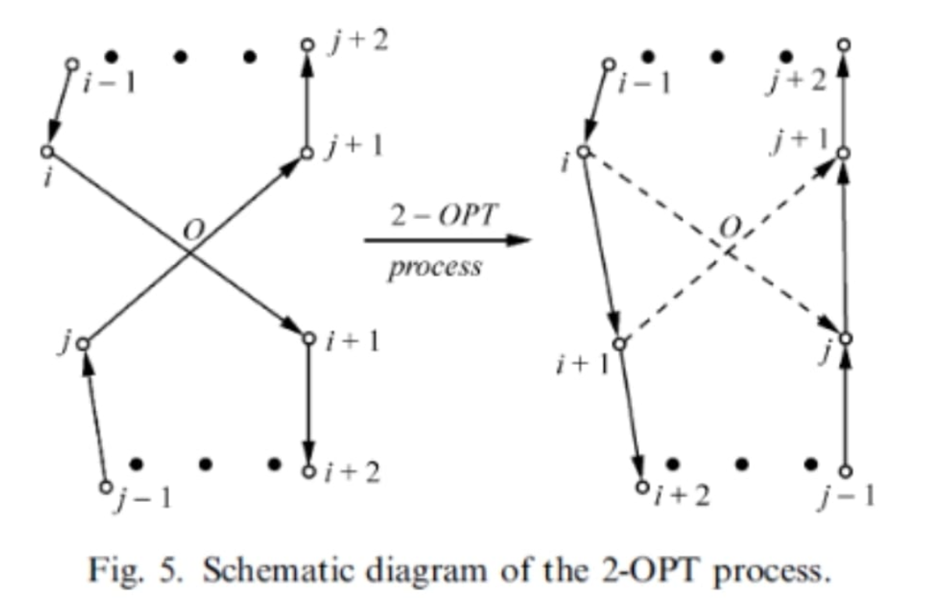
Algorithmic Steps:
Initialize: Start with an initial tour of the TSP.
Identify 2-opt Moves: Identify all possible 2-opt moves that can be applied to the current tour.
Perform 2-opt Move: Select the 2-opt move that results in the largest reduction in tour length and apply it.
Repeat: Repeat steps 2 and 3 until no further 2-opt moves can be found.

Slide 31
Mathematical Formulation:
Let G = (V, E) be a complete undirected graph with n vertices, where V = {v1, v2, ..., vn} is the set of vertices and E is the set of edges. Let d(u, v) be the distance between vertices u and v. The TSP is to find the shortest Hamiltonian cycle in G, which is a cycle that visits each vertex exactly once.
The LK heuristic can be formalized as follows:
Input: A tour T of the TSP Output: An improved tour T' T' = T while there exists a 2-opt move (u, v), (w, x) in T' such that d(u, v) + d(w, x) > d(u, w) + d(v, x) T' = swap((u, v), (w, x)) in T' end while return T'
Time complexity of the LK algorithm
O(n^2), where n is the number of cities

Slide 32
Conclusion:-
The Lin-Kernighan (LK) algorithm is a powerful and efficient heuristic for the traveling salesman problem (TSP). It can produce high-quality solutions to TSP problems with thousands of cities. While the LK algorithm is not guaranteed to find the optimal solution, it is a valuable tool for solving a wide range of TSP problems.
Problems that this research paper Has Solved Effectively
The LK algorithm has been used to solve a variety of TSP problems, including problems with thousands of cities.
The LK algorithm has been shown to be effective in a variety of applications, including logistics, scheduling, and circuit design.
Future outlook:-
The LK algorithm is a powerful tool for solving the TSP and is likely to continue to be used in the future.
However, the LK algorithm is not without its limitations. The LK algorithm is not guaranteed to find the optimal solution to the TSP, and its running time grows quadratically with the number of cities.
Despite these limitations, the LK algorithm is a valuable tool for solving a wide range of TSP problems.

